Slide 1
EMPLOYER PERCEPTIONS OF DIGITAL BADGES
IMS GLOBAL QUARTERLY MEETING
VICTORIA RAISH AND EMILY RIMLAND
Notes:
Torrie

Slide 2
PRESENTATION OBJECTIVES
Inform community on employer perceptions of digital badges
Explore the information literacy skills that employers are not seeing in recent college graduates
Look for differences across industries regarding both badges and information literacy preparedness
Notes:
Emily

Slide 3
Broad Strokes
114 HR employees of various industries completed surveys online. In a second survey we had 306 surveys.
Most respondents represent private companies. The most common industry was professional services, followed by IT.
Job openings receive 25-75 applications. Most employers expect to hire the same or more entry-level graduates in the next few years. (2015)
Our full article at: https://doi.org/10.5860/crl.77.1.87
Employer Perceptions of Critical Information Literacy Skills and Digital Badges
Notes:
Emily

Slide 4
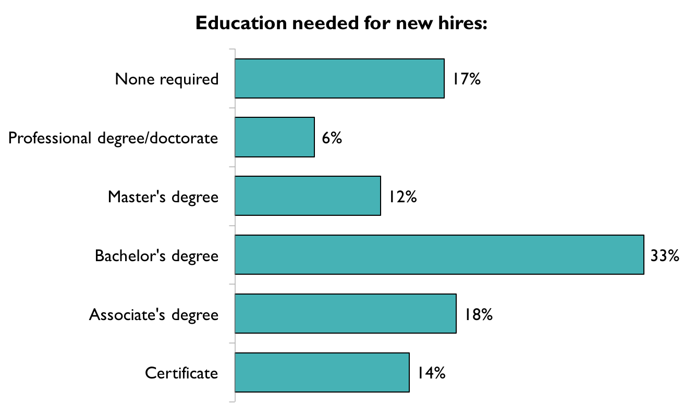
Notes:
The chart displays what that education distribution would look like for an average institution.
Emily

Slide 5
Characteristics of Recent College Graduates
What they have
What they do not have
Effective communication
Ability to problem solve
Job specific knowledge
Ability to find patterns
Apply knowledge to real-world contexts
Ability to work with diverse perspectives
Most Valued Experiences
E-portfolios
Standardized test scores
Courses related to major
Ability to demonstrate learning beyond the classroom
Least Valued Experiences
Notes:
Emily

Slide 6

Broad Strokes: Digital Badges
All employers agree that a more specific representation of a student’s skills would be helpful
33% interested in seeing students’ badges, 62% interested with more information
Filtering tool would be very helpful
Typical employer would look at 5 or fewer digital badges
No differences across industries
Notes:
Torrie

Slide 7
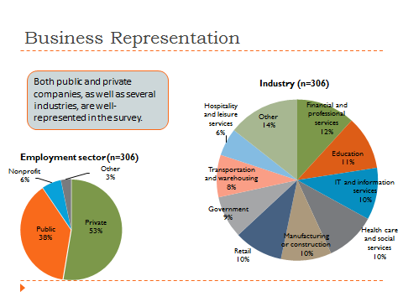
Notes:
This was our sample for the second survey we conducted - each category has at leeast 30 participants in order to have power to make comparisons between groups.
Torrie

Slide 8
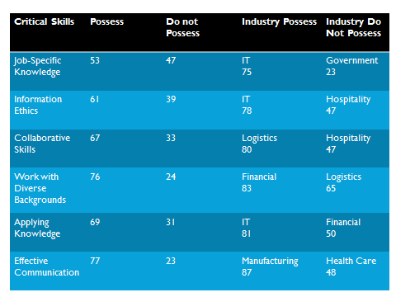
Notes:
Torrie

Slide 9
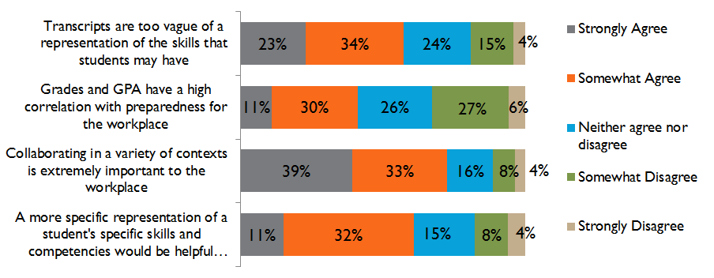
Notes:
Torrie

Slide 10
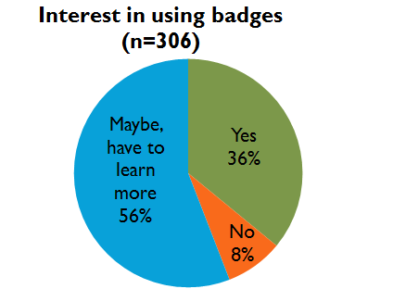
Notes:
Torrie

Slide 11
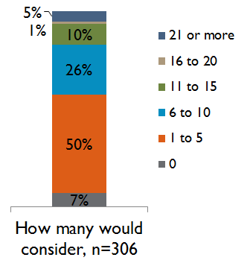
Number of Badges to Evaluate
Notes:
Torrie

Slide 12
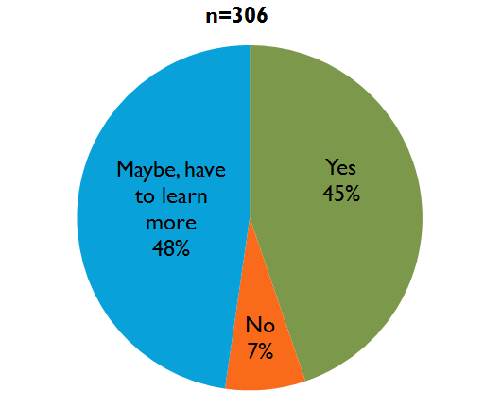
Keyword Filtering
Tool
Notes:
Torrie

Slide 13
Badging Interest by Industry
Manufacturing and IT most interested in badges at 54% and 66%
Hospitality and leisure, retail, and logistics most unsure at 88%, 53%, and 54%, needing to learn more about badges prior to expressing interest
Notes:
Torrie

Slide 14
Literacy Skill Group | Average Importance | Likelihood of possession
Critical thinking | 5.3 | Ability to solve problems on their own when there is an unclear outcome: 50% Ability to apply knowledge to real-world contexts: 29% Ability to find patterns and make connections: 18%
Continuous/lifelong learning | 5.2 | A desire to learn new skills on the job: 49%
Collaborative interaction | 5.1 | Ability to use collaborative skills to help solve problems: 50% Ability to learn how to work with people from diverse backgrounds: 29%
Information ethics | 5.1 | Ability to identify and understand ethical information issues: 38%
Finding and using information | 4.8 | Job-specific knowledge or training: 61%
Notes:
This is from our first survey but groups things nicer than the second survey,, we can mention this is from the 2013 survey with employers
Torrie

Slide 15

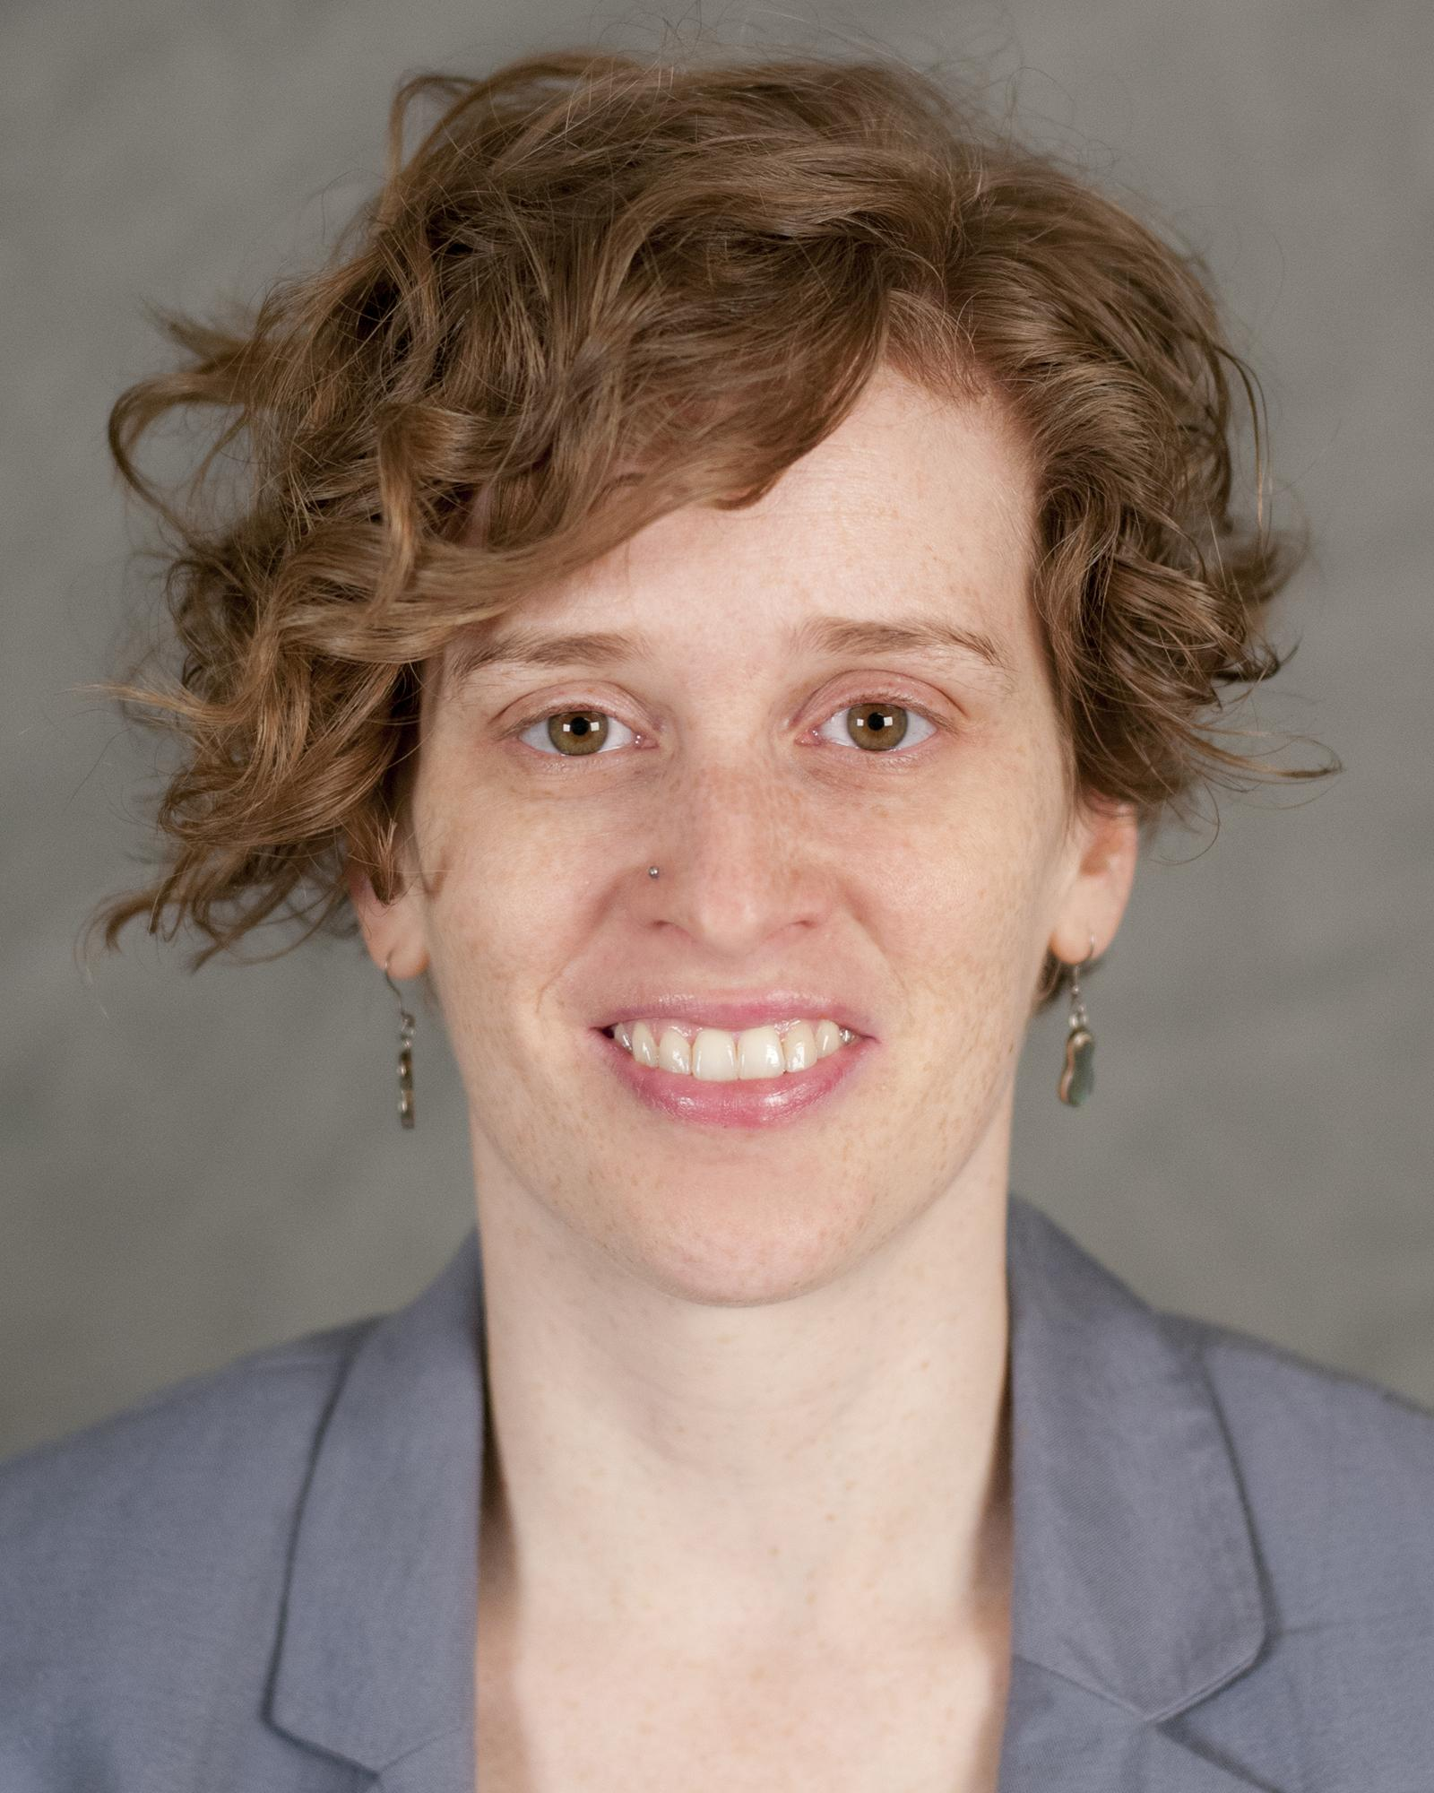
Discussion and Contact Information
Victoria Raish
Online Learning Librarian
victoria@psu.edu
@raishvictoria
Emily Rimland
Information Literacy Librarian
erimland@psu.edu
@gruenelf
Notes:
/emily/Torrie

