Slide 1
Lessons Learned from the Badges for Lifelong Learning Initiative (AKA, where open digital badges appear to have worked better) Daniel T. Hickey Indiana University IMS Open Badges Community Meeting

Slide 2
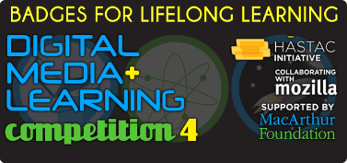
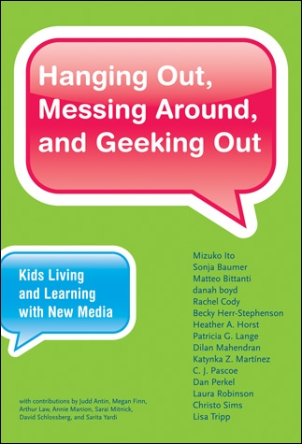
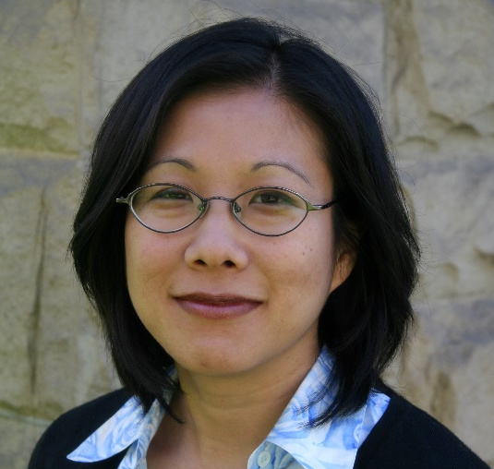
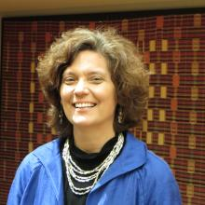
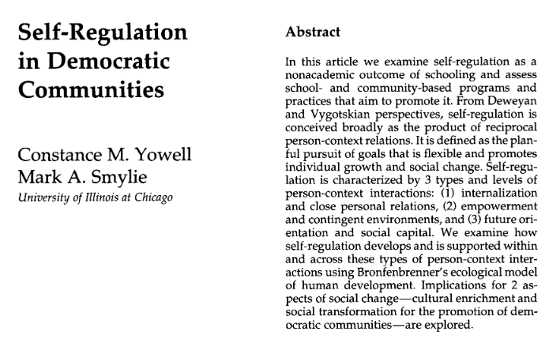
Mimi Ito
Connie Yowell

Slide 3
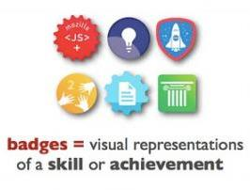
DIGITAL BADGES CONTAIN INFO
Claims & evidence; links to more
Contain specific claims of competence
Contain evidence supporting claims
Links to more evidence including student work
This is different from conventional credentials
Can link to unlimited additional information
It matters what claims and evidence are included
Process is transformative and/or disruptive

Slide 4

OPEN BADGES CIRCULATE
Info circulates in value networks
Credibility of claims and validity of evidence gets “crowdsourced”
Earners can find opportunities and promote achievements
Institutions can recognize broader accomplishments
Employers can communicate needs and find skills
Amplifies meaning of claims and evidence
Amplifies deliberation over nature of claims and evidence

Slide 5
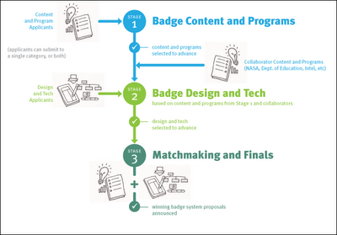
The Design Principles Documentation Project
Studied 2012 DML content awardees
600 badge content proposals
29 content developers supported
3 platforms supported

Slide 6
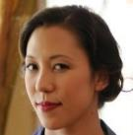










Collaborators & Partners
Rebecca
Itow
James
Willis
Katerina
Schenke
Cathy
Tran
Nate
Otto
Christine
Chow
Joshua
Quick
Cindy Cogswell
Notes:
This is my team
I did my PhD in psychology at Vanderbilt and have spent most of my career doing assessment and evaluation with cutting edge educational technology. Jasper Woodbury videodisks at Vanderbilt, GenScope Multimedia software as a postdoc at the ETS center for performance assessment and on the faculty at Georgia, NASA Classroom of the Future as a faculty member in Georgia, and Quest Atlantis, Sakai, and Project NML at Indiana. So of course I am thrilled to be working with what I think will be the most important technology of all.
I also study motivation and incentives, and have thought about badges a lot. I have done empirical studies of them in both Quest Atlantis and Sakai and hope to have them published soon.
I focus on the implications of sociocultural theories of knowing and learning for assessment, motivation, research, and evaluation. There is a research literature in each area that is directly relevant to the goals of the DML initiaive
This is my team,
Happy to be working with Shery Grant and others at HASTAC—you are in the hands of a very capable team there and we have had lots of discussion about how we can help serve both the initiative and individual projects
Also thrilled to be working with Mozilla. Erin Knight has been awesome. As I will show you Carla Casilli is introducing some very important ideas, and I understand that Peter Rawsthorne form England is joining the team as well.
Technically most of my work will be through HASTAC and focused on awardees. But there is an enourmous community of finalists out there who have been inspired by the compeition and are forging ahead as we speak.

Slide 7
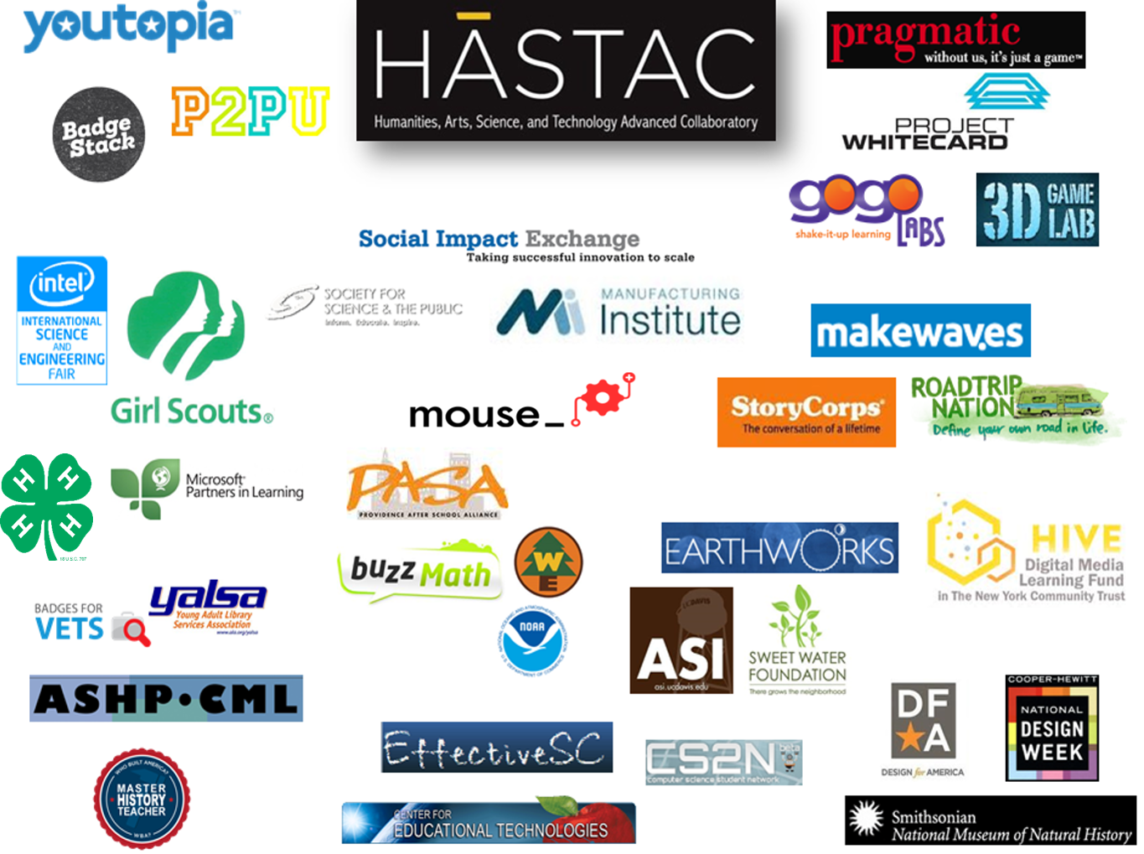

Slide 8
Earners
Standards
Setting
Accreditation

Slide 9
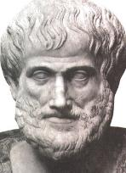
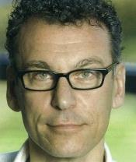

Capturing “Practical Wisdom”
Aristotle’s Phronesis
Contextual and value-laden
Bent Flyvbjerg (2001)
Phronetic narratives
Rich Halverson (2004)
Artifact-based phronetic narratives

Slide 10




Categories of Badge Functions
Recognizing Learning
Assessing Learning
Motivating Learning
Studying Learning

Slide 11



Emergence of Badge Design Principles
Draft Initial Principles
Formalize General Principles
Bookmark Research

Slide 12
Badges appear to work better… In some places than others

Slide 13
Badge System Status in 2014

Slide 14
Badge System Status in 2015

Slide 15
How did badges work… where learning was competency-based?
Seven projects were CBE
Self-paced, rejected “seat time”
Mostly for course credit
Summative assessment (of specific competencies)
Extrinsic motivation (i.e., credit, points, etc.
Competency badges
Measurable and measured competencies
Notes:
Across other projects, Pathways to Global Competence also had a focus on designing badges based on comeptencies and was ultimately unable to get the badge system up and running. With an industry-related focus, Manufacturing Institute and YALSA also featured competencies in their badge system, with a greater emphasis on professional development for YALSA (which gradually scaled back from multiple badges for specific competencies to a single badge for professional's achievements).

Slide 16





How did badges work… where learning was competency-based?
SA&FS was suspended
All three Gates Project Mastery awardees were all suspended
Pathways to Global Competency (Asia Society)
Level Up (Colorado)
Youth Film Maker (Philadelphia)
Manufacturing Institute
SkillsUSA badge suspended
PLTW badge is seldom earned
YALSA badges are seldom earned
Buzzmath badges are not open but thriving
Notes:
Across other projects, Pathways to Global Competence also had a focus on designing badges based on comeptencies and was ultimately unable to get the badge system up and running. With an industry-related focus, Manufacturing Institute and YALSA also featured competencies in their badge system, with a greater emphasis on professional development for YALSA (which gradually scaled back from multiple badges for specific competencies to a single badge for professional's achievements).

Slide 17
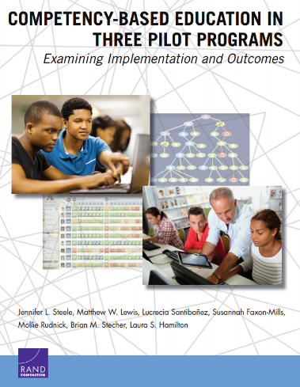
Challenges that Rand Corp Evaluation Uncovered for Gates Project Mastery Projects
Equating evidence with conventional criteria
Determining who can authorize credit
Maintaining a common definition of proficiency
Building a sustainable model
Equitable education
Barriers to efficiency
Technical
Financial barriers
Logistical barriers

Slide 18
How did open badges work… where learning was participatory?
Five project emphasized engaged participation
Cohorted course-based contexts
Crowdsourced recognition (e.g, communal badges)
Transformative assessments
Social motivation (e.g., team goals)
Participation Badges
For assuming roles and identities

Slide 19
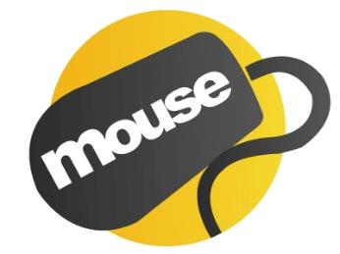




How did open badges work… where learning was participatory?
MOUSE network mentors high school tech support
Thriving, many successful grads
S2R network for high school media producers
Thriving, many successful grads
PBS Student Reporting Labs for high school media
Thriving, many successful grads
Cooper-Hewitt/Smithsonian Design Prep helps high schoolers develop design portfolios
Stated out more competency-based badges but thriving with role-based participatory badges
Design for America for undergraduate social design and engineering projects
Implemented Digital Loft badges
Program thriving but badges appear paused

Slide 20
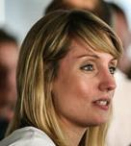
How did badges work… on the Supporter to Reporter Project?
Layered badges into existing youth sports journalism project
Cohorts at sports clubs and schools
Learning was social and networked
“Role-based” badges
Multi-point endorsement by peers, teachers, and public
Project and badges are thriving
Badges leading (indirectly) to internships and admissions
Just released Open Badge Academy
Lucy Neale Lewis

Slide 21
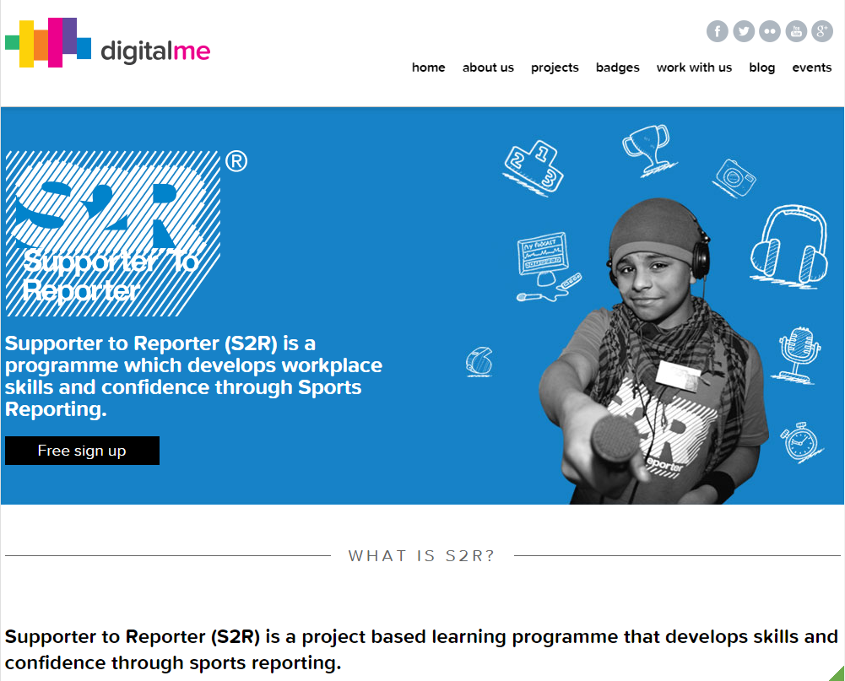

Slide 22
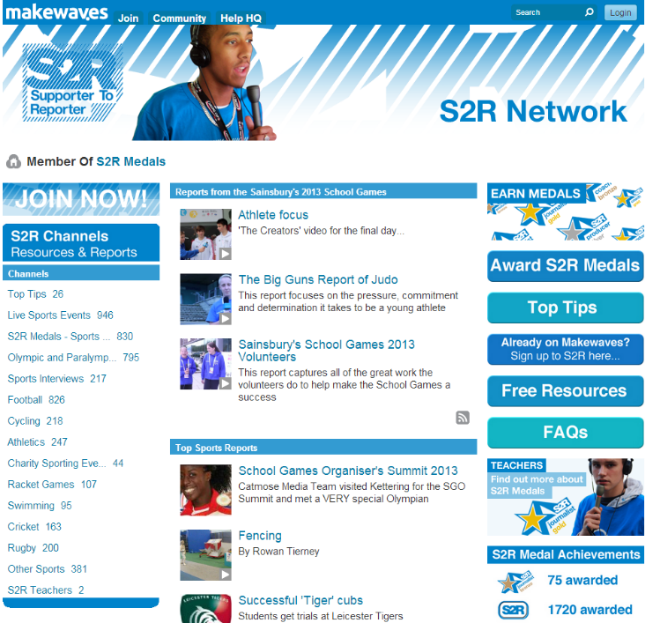

Slide 23
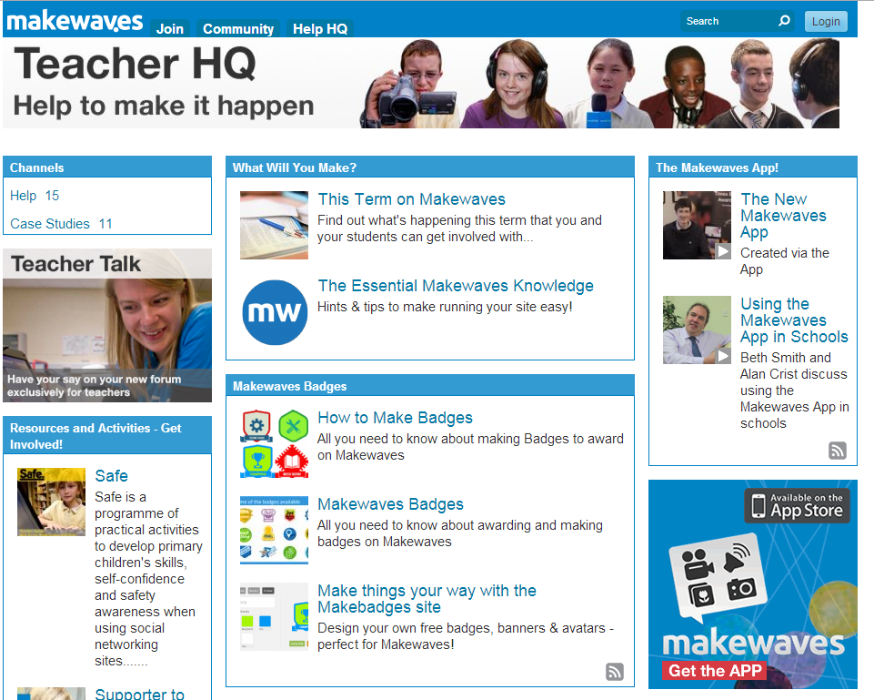

Slide 24
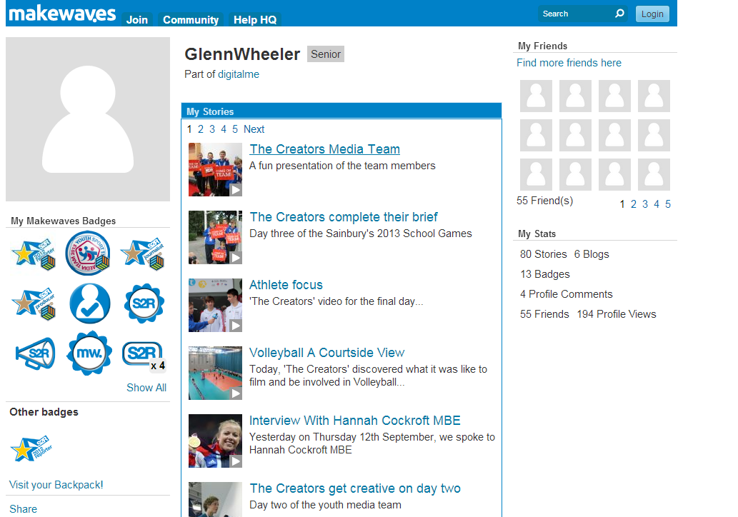

Slide 25
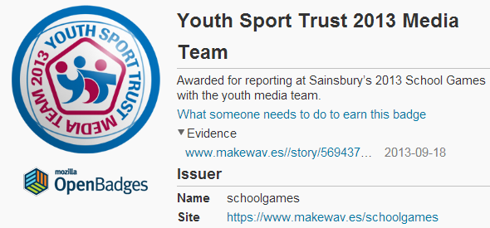

Slide 26
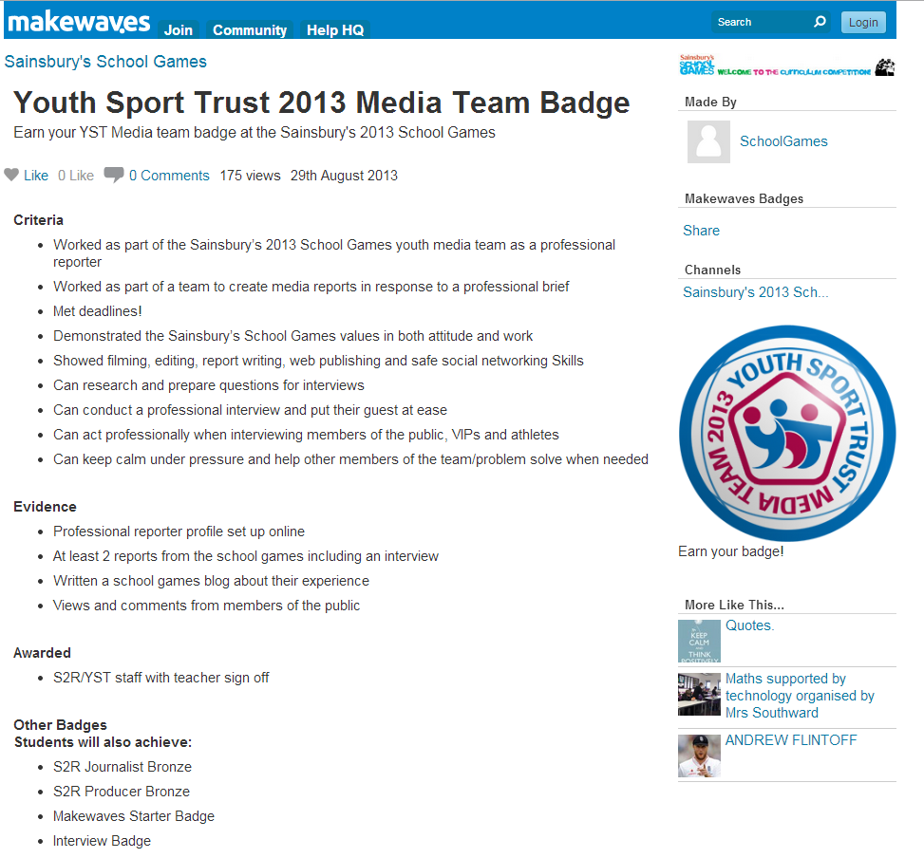
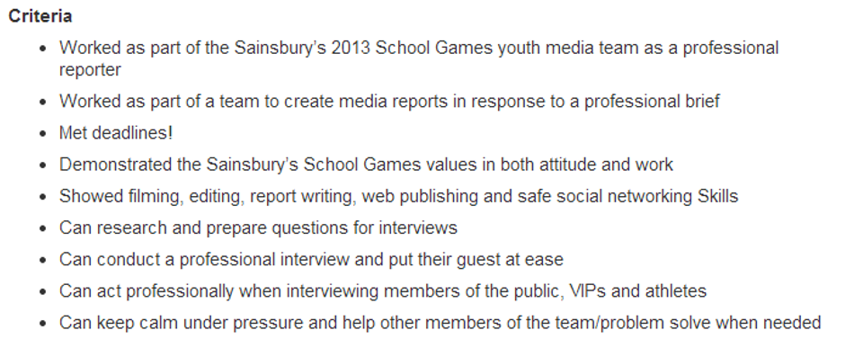
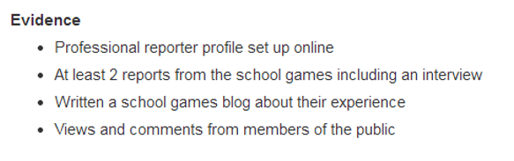

Slide 27
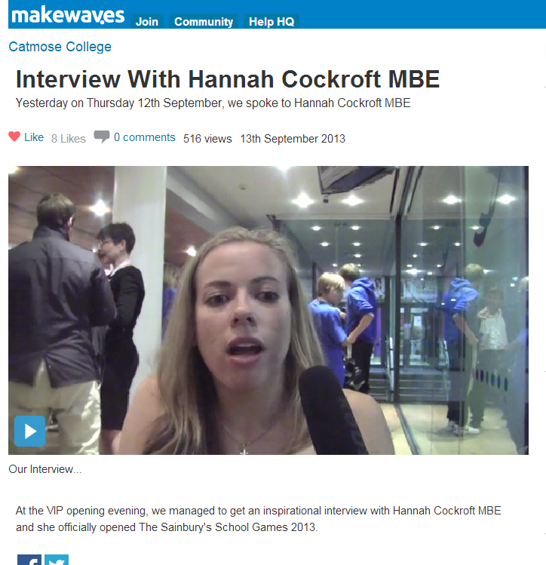

Slide 28

“Role Based” Badges at S2R for Success
Badges for taking on professional roles
“Distance traveled” rather than level met
Already abandoned formal credentialing
Aiming for “carry over” of competencies
https://www.youtube.com/watch?v=w9-sddUCHKg

Slide 29

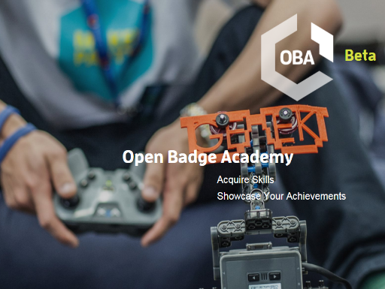


Slide 30
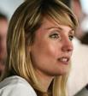

Lucy Lewis on the philosophy of OBA “role badges”
Unlike Linked In, Open Badge Academy is about getting endorsements after you have earned a badge. People can come and add endorsements to the evidence. For example, one of the ways you can earn a badge is for an internship. You earn the badge on completing the internship. You can add that you thought it went well. The employer can also add an endorsement, adding additional feedback; your peers can do that too. The idea is building trust via multipoint validation.

Slide 31
Lucy Lewis on the philosophy of OBA “role badges”
We like to use the e-Bay comparison when we talk about badges…building an endorsement of your learning and achievement from lots of different points. It can be from an expert, it can be from an educator, from peers, and so on. These things together create a rich and credible credential that you can use in lots of different ways. Arguably this is more valuable from an employer’s perspective because it is like getting a CV with the reference and the evidence built in, versus a qualification that does not have all of that context around it.

Slide 32

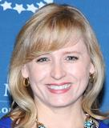
How did Badges work… at Student Reporting Labs?
Connects secondary classrooms to local PBS stations to produce original videos
Students work in cohorts and teams
Nine lessons in three units
News Media 101, Constructing News, and Putting it all Together
Badges contain videos, reports, and other artifacts.
Artifacts are evaluated holistically
Project and badges are thriving
Over 100 middle and high schools
Issued 300+ SRL Fellows badges in 2015
The badges are very prized by earners
Added a new STEM badge in 2015
Badges are (indirectly) generating internships and jobs
Leah Clapman
Stacy Kruse

Slide 33
How did open badge work… on the MOUSE Wins! Project?
Layered badges into IT support network for secondary students
Networked cohorts and teams
Social learning, recognition, and assessment.
Badges awarded for participation
“Team-based” badges
Extensive peer review and discussion
Project and badges are thriving
Badges leading (indirectly) to jobs, internships, and admissions

Slide 34
How did open badge work… where learning was inquiry-based?
Twelve projects emphasized more constructivist practices
Inquiry-oriented and project-based contexts
Informal recognition
Formative assessment (e.g., open-ended, rubrics, etc.)
Intrinsic motivation
Completion badges
Assessable and assessed
Assessment was a big challenge
More modest assessments and scaled back assessment in thriving projects

Slide 35
How did open badges work… where practices were hybrid?
Five projects were hybrids
Generally were broader learning contexts
Associationist, constructivist, and sociocultural activities
Mix of recognition and assessment practices
Various forms of motivation
Competency, Completion, and/or Participation Badges
Assessment again a challenge
Thriving projects scaled back or automated assessment

Slide 36
Badges appear to work better… where external endorsements are based on existing relationships
Eleven sought external endorsements by name
Four succeeded by drawing on existing relationships (CS2N, 4-H, Intel, Smithsonian)
Six were unable to secure endorsements
Lack of familiarity and term “badge” may have been factors
Only Planet Stewards established endorsements
NOAA allowed them to use the name but not the logo
Was a major inestment

Slide 37
Badges work better… as informal credentials that speak for themselves
Eight sought external value with commitments
Only CPB SRL succeeded with local internships
Cooper-Hewitt, Intel, and Planet Stewards all unable to get traction with admissions
Few systems and fewer partners recognized evidential potential of badges
Tried to insert badges into existing credential frameworks

Slide 38




The Badgescape in 2017
Project LRNG
Badge Alliance ends with OBS 2.0
IMS takes over OBS 2.0
JSON-LD
Endorsement 2.0
Concentric Sky updates Badgr.io

Slide 39
Six Arguments About Motivating Networked Learning with Open Badges
The information in badges is inherently meaningful
Open information is even more meaningful
Open credentials are particularly disruptive and transformative
The intrinsic/extrinsic dichotomy is overstated
The negative consequences of extrinsic rewards is overstated
Situative models of engagement are ideal for motivating learning in digital networks.
Hickey, D. T., & Schenke, K. (in preparation). Badges and rewards. In K. A. Renninger & S. E Hidi, The Cambridge Handbook of Motivation and Learning. Cambridge, MA: Cambridge University Press

