Slide 1
Digital Learning rEvolution Program

Slide 2
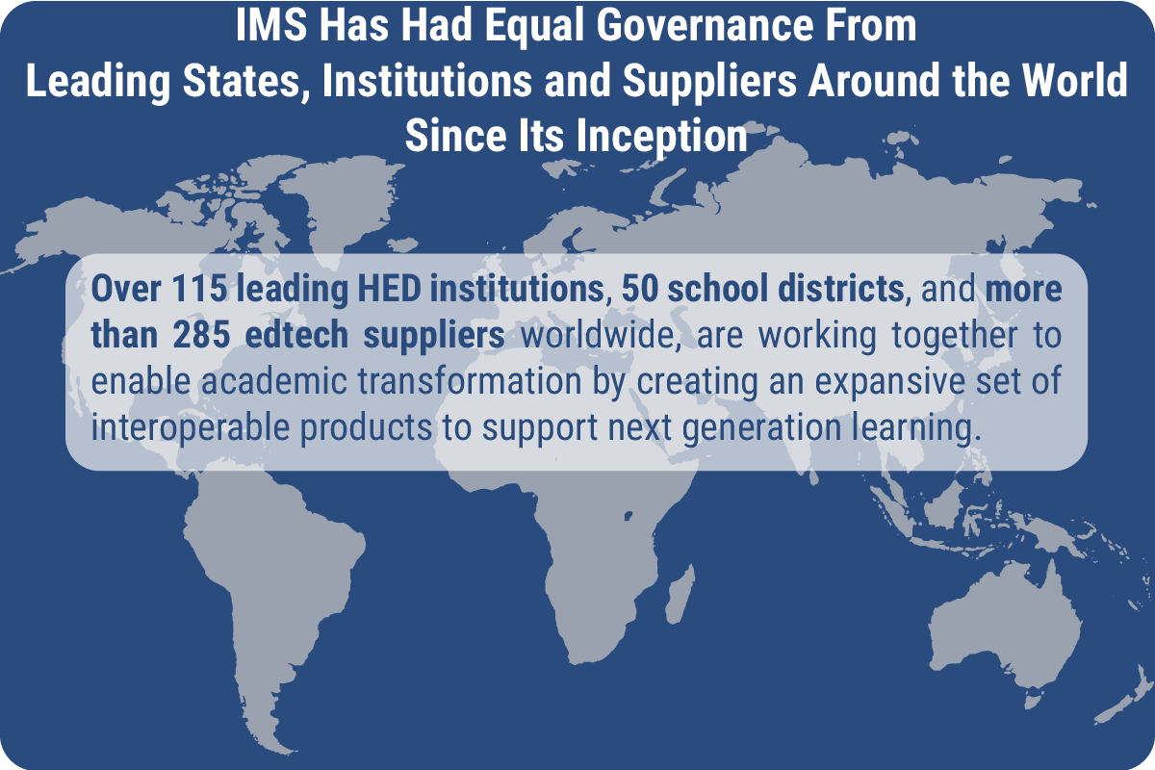
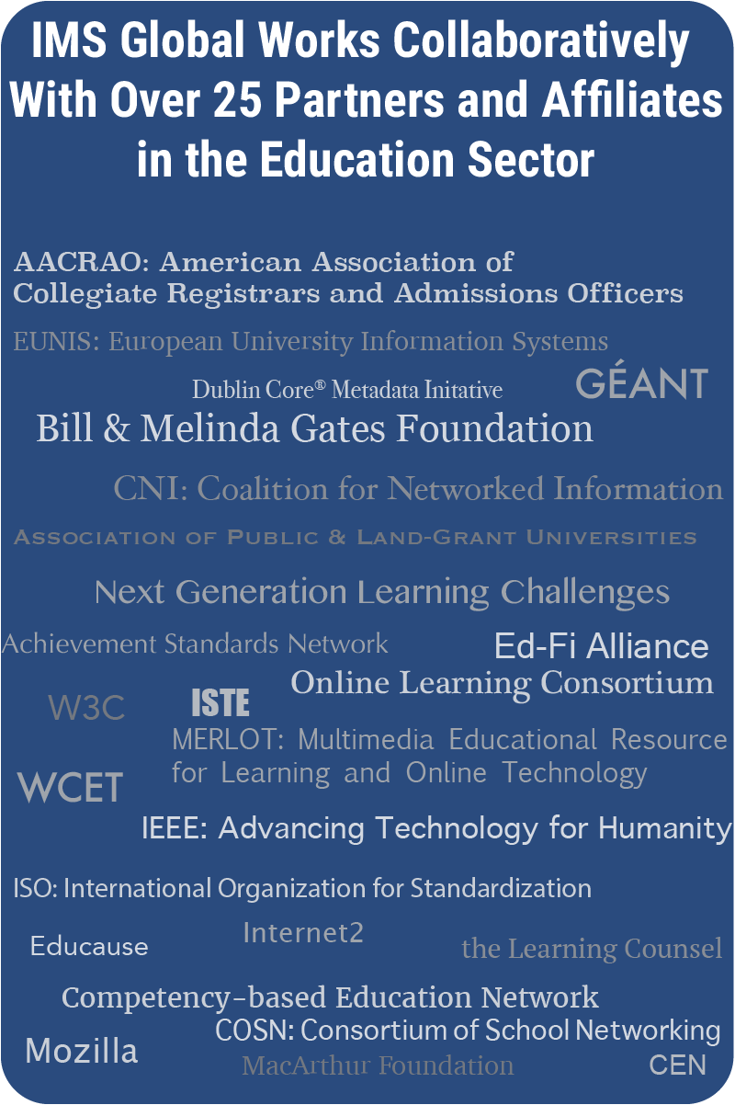
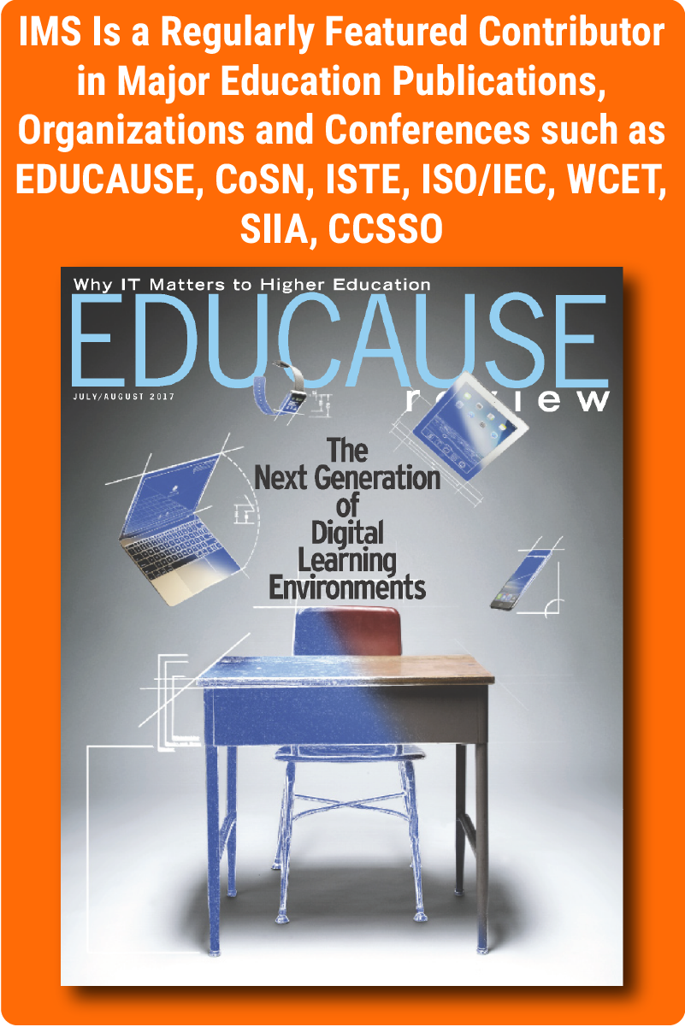
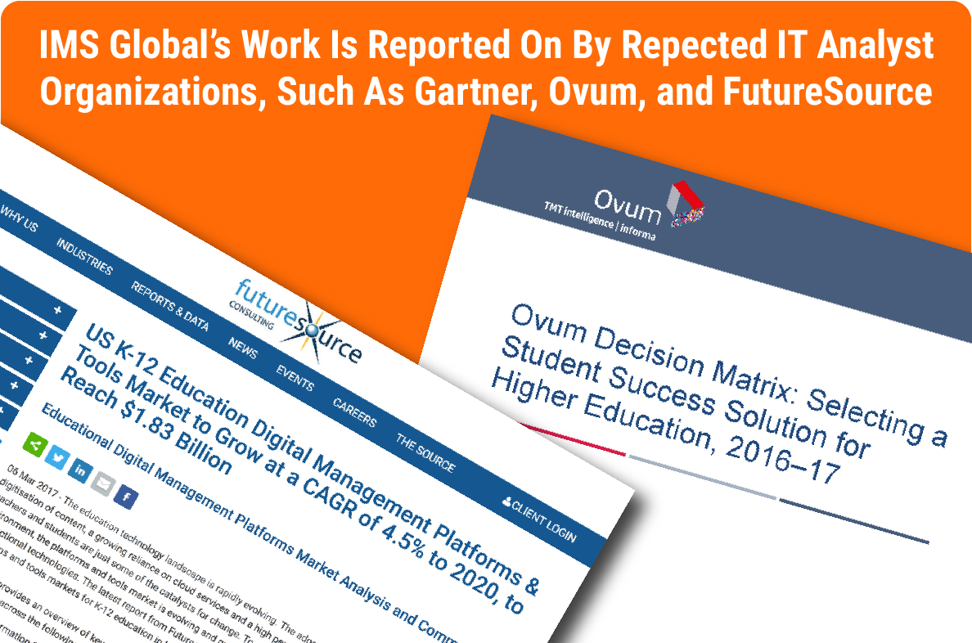
Who is IMS Global Learning Consortium?
Notes:
International non-profit edtech collaborative enabling Better Learning from Better Learning Technology®
425+ members (and continuously growing) representing state educational agencies, school districts, higher education institutions, and edtech suppliers
Working together to guide, develop, and adopt the IMS ecosystem—innovative products that work together seamlessly to increase quality teaching time and digital classroom innovation while reducing cost

Slide 3
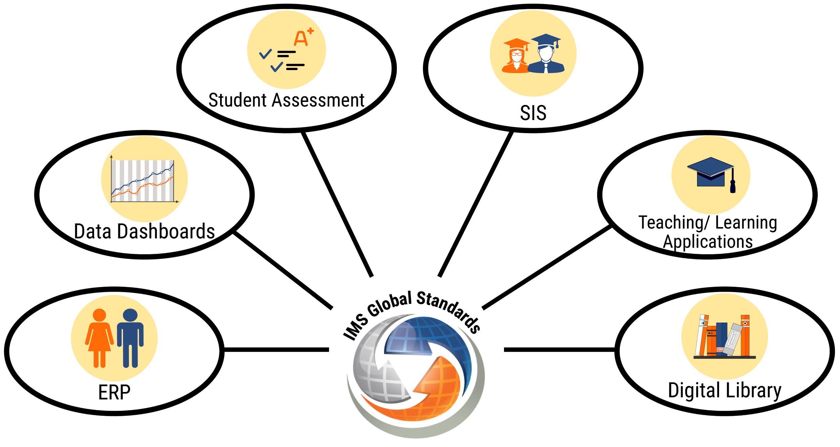
Digital Systems Need to Work Together for Your District’s Needs
Notes:
IMS Global Standards allow all of the various software systems in a school district to work together. Using the Digital Learning Revolution Program, districts can evolve their ecosystem until all systems are working together seamlessly.

Slide 4
What is Really Required?
Interoperability standards that work and are voluntarily adopted by a majority of the market resulting in a rich ecosystem of choices
District/state understanding of what standards to ask for and how to ask for them to ensure you can fully benefit from the ecosystem
District/state leadership in developing a strategy, plan and processes for phased adoption towards your unique goals
Community leadership to keep advancing into the future
Net-net: Results Now and Greater Impact Every Year
Notes:
Collaboration with like-minded districts through membership in IMS Global is a key strategy districts can take to help evolve the ecosystem. Being able to work side by side with districts that are working on the same issues as well as having access to districts that have “been there and done that” is particularly useful.

Slide 5
IMS rEvolution Program Leadership
The IMS Revolution is led by over 211 institutions and state DOEs to create an ecosystem of edtech products that are less expensive to integrate, offer greater choice and flexibility to enable innovation, and provide better analytics and insights to improve student success.
Rapidly growing plug-and-play product ecosystem of digital resources enabled by over 410 edtech products from 260 leading suppliers that have achieved IMS conformance certification.
Verifiable claims of via certification by checking the IMS Certified Product Directory at www.imscert.org.

Slide 6
Digital Learning rEvolution Program
Notes:
The digital learning revolution program is a Four tiered program to Help Districts Adopt the IMS Standards-Based Ecosystem
It offers a Simple, incremental evolution of IT infrastructure and instructional practices while also
Enabling advanced revolutionary uses of digital technologies to accelerate relevant, rigorous, and innovative teaching practices

Slide 7
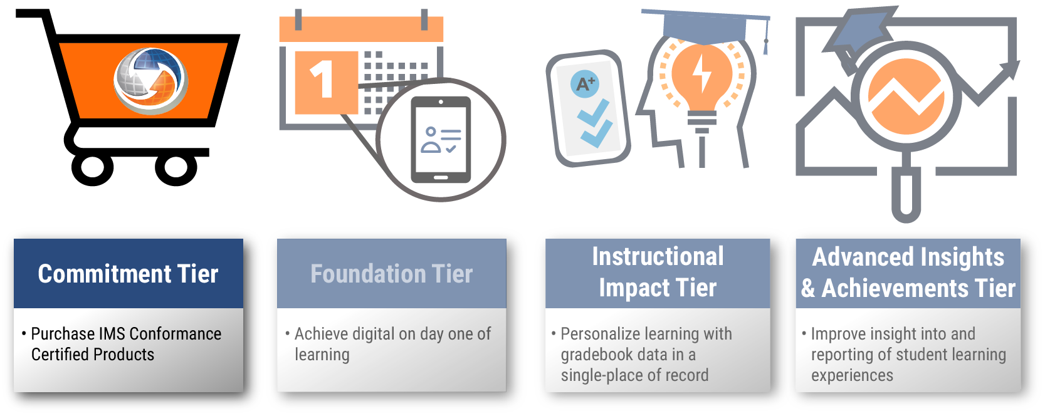
Digital Learning rEvolution Program
Notes:
To get started, The Commitment Tier is when school districts make the decision to purchase IMS Conformance Certified Products.

Slide 8
Commitment Tier: IT and Teaching & Learning Benefits
Begin to establish a plug-and-play ecosystem
Gain resources to help you know what to ask for from vendors
Know what to include in RFPs
IMS Global’s conformance certification program guarantees interoperability among a wide range of products
Get assistance from IMS for those who need help determining their needs
Notes:
With IMS Global Conformance Certified Products, school districts can confidently begin to establish a plug-and-play ecosystem. IMS Global’s conformance certification program guarantees interoperability among a wide range of products.
Ensuring that your educational technology tools are IMS Global Certified is the best way to establish a plug and play ecosystem that allows all of your tools and content to work together. If you are just starting out, you should review some of the resources IMS Global has developed to help you know what to ask for from your vendors and what to include in your RFPs.

Slide 9
Digital Learning rEvolution Program
Notes:
The Foundation Tier is a key part of the IMS Global Digital Learning Revolution Program. In the Foundation Tier, school districts focus on the capabilities that support digital learning from day one of school including rostering, single sign-on and launching of applications.

Slide 10
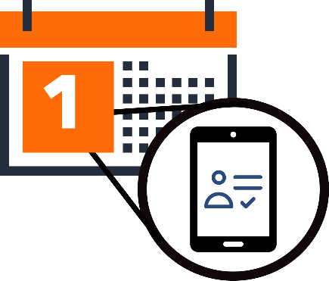
Foundation Tier: IT Benefits
Save time and money while provisioning users and automatically authorizing software applications (OneRoster®)
Establish a trusted connection between applications for ongoing transfer of data while providing a single sign-on user experience (Learning Tools Interoperability®)
Secure your investment in LMS-created course content (Common Cartridge® export)
Notes:
Save valuable instructional and administrative time with a low cost and scalable way to automatically populate rosters in teaching and learning tools

Slide 11
Foundation Tier: Teaching & Learning Benefits
Automatically populate rosters in teaching and learning tools
One-click, seamless launching for teachers and students from the most relevant and convenient access point (LMS, portal, LOR)
Offers the greatest choice of products available in a one-stop shop (IMS Certified Product Directory via imscert.org)
Notes:
Make one-click, seamless launching of digital learning objects for teachers and students from the most relevant and convenient access point whether it be an Learning Management System, Learning Object Repository, or Portal or all three a reality.

Slide 12
Digital Learning rEvolution Program
Notes:
In the Instructional Impact Tier of the Digital Learning Revolution Program, IMS Global helps school system’s integrate multiple sources of digital curriculum, learning apps and tools and assessment products and reduce the administrative overhead for teachers by integrating gradebook data in one place.

Slide 13
Instructional Impact Tier: IT Benefits
Easy systems-level configuration of tools (LTI Advantage)
Choose and switch providers by ensuring that content and data are easily transferred among systems (Thin Common Cartridge®)
Ensure data integrity by removing the need to manually re-enter assignment scores from various tools into the gradebook (OneRoster Gradebook Services)
Notes:
Make it easier for teachers and students to get all their digital learning objects in one place by integrating multiple sources of digital curriculum, learning apps and tools, and assessment products together.

Slide 14
Instructional Impact Tier: Teaching & Learning Benefits
Integrate multiple sources of digital curriculum, learning apps and tools, and assessment products
Access to discrete learning objects and assessment items in the right place at the right time
Means for collecting assignment scores and grades across a wide array of digital resources in a single place of record
Enables integration of a variety of summative and formative assessment products, including third-party item banks, to provide educators with actionable data to inform student interventions and instruction
Notes:
And enable the integration of a variety of summative and formative assessment products, including third-party item banks, to provide educators with actionable data to inform student interventions and instruction.
Reduce administrative tasks for teachers by removing the need to enter grades into the gradebook from other applications! It can happen automatically.

Slide 15
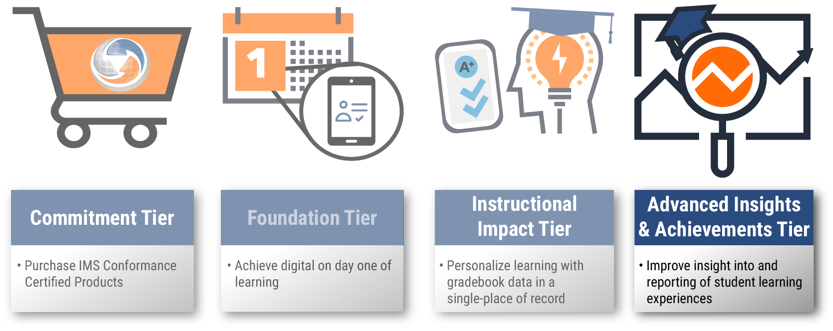
Digital Learning rEvolution Program
Notes:
In the Advanced Insights and Achievement Tier of the Digital Learning Revolution Program, IMS Global helps school systems improve insight into and reporting of student learning experiences.

Slide 16
Advanced Insights & Achievement Tier: IT Benefits
Understand and visualize product usage data from different sources and present this information to students, faculty, and advisors in meaningful ways (Caliper Analytics®)
Ensure easy data aggregation for items aligned to learning standards by implementing a universal identifier across all products (Competency and Academic Standards Exchange™ (CASE™))
Quickly and securely integrate digital badging platforms with other systems without requiring custom integrations (Open Badges)
Simplify record-keeping and transmission of digital student records (Extended Transcript)

Slide 17
Advanced Insights & Achievement Tier: Teaching & Learning Benefits
View students’ product usage to better understand the return on learning of technology investments
Provide educators a faster and more reliable way to align and realign content to learning standards, find and share content from different sources, and support the transition to standards-based and competency-based learning
Present achievements that are verifiable and portable to help learners differentiate their career-readiness in an increasingly competitive world
Improve the ability to digitally represent and report a learner’s academic and co-curricular record, and make it easier for the learner to share achievements with prospective employers

Slide 18
Get Started with the Digital Learning rEvolution Program NOW!
Defines strategy, plan and processes for migrating to your interoperable digital learning ecosystem
Develops a shared vision across district IT and curriculum and instruction of how open technologies will support the district’s strategic and operational goals
Facilitates a process for setting priorities and making decisions regarding the evolution of the district’s technology in coordination with other leading districts and states
Discover which of your products are IMS Global conformance certified.
Learn more at imsglobal.org/k12-revolution
Notes:
IMS Global’s Digital Learning Revolution Program helps school districts plan strategically for the evolution of their institution’s digital learning environment into a plug-and-play ecosystem. It also scales to provide vision and leadership for revolutionizing teaching and learning through powerful practices and open technologies.

Slide 19
Ready to Commit?
Sign up now and IMS will contact you to schedule an orientation call to help you get started.
imsglobal.org/k12-revolution

